Slide 1
ILP: Hardware Based Speculation and Multi Issue
Prepared by Shafia Hussain

Slide 2
Hardware-Based Speculation Dynamic Branch Prediction + Dynamic Scheduling + Speculation
Control dependencies pose major hurdle to ILP.
Branch prediction reduces the stalls but in an out of order processor, instructions wait for it’s result to execute.
Speculation goes a step further and executes the instructions suggested by the branch prediction
This is accomplished by introducing two separate stages after instruction execution; Completion, and Commit.
Instruction result is available to the dependent instruction after the Completion stage.
Result is written back to registers in Commit after the result of branch is known.
If the branch prediction was wrong none of the completed instructions from the branch prediction are committed

Slide 3
Reorder Buffer
A circular buffer named Reorder Buffer (ROB) is added after functional units.
The completed results reside in it until the instructions are no more speculative i.e. branch result is known.
It has two pointers which point to it’s head and tail. At start both point to same location.
With each new instruction tail pointer increments
Head pointer increments with each commit.

Slide 4
Reorder Buffer
The ROB entry number is recorded in the RSs for operands that are produced by instruction
Each entry in the ROB contains four fields: the instruction type, the destination field, the value field, and the ready field which indicates that instruction has completed execution.
Reorder buffer also replaces store buffer. Store writes the result in commit stage which is the second step of store execution

Slide 6
Steps of Execution Issue
Instruction only issued when there is empty slot in both the reservation station and ROB
Operands are provided if they are available in registers or ROB
The no of ROB entry is also sent to RS which is used as a tag to get result when it is broadcasted on CDB
In order issue, so
No RAW hazard for register instructions
No WAR hazard for register and memory instructions

Slide 7
Steps of Execution Execute
If operands are not available, monitor the CDB
Load has two execution steps which complete in this phase
For Store only effective address computation is completed. Data is written to memory in commit stage. So store only need base address at this stage.
RAW hazards through memory are maintained by two restrictions:
Maintaining the program order for the computation of an effective address of a load with respect to all earlier stores.
Not allowing a load to initiate the second step of its execution if any active ROB entry is occupied by a store having same address

Slide 8
Steps of Execution Write Result
Result is written to CDB with it’s ROB tag, from where it reaches ROB and any RS waiting for result
RS is marked available.
For store instructions, if the value to be stored is available, it is written into the Value field of the ROB entry otherwise, the CDB must be monitored until that value is broadcast

Slide 9
Steps of Execution Commit
Three scenarios when an instruction reaches the head of ROB
Branch
If it is true then it’s execution completes here
Otherwise all the ROB is flushed and execution is restarted from the correct instruction
Store writes to the memory location if data is available
Other normal instructions write their results to registers.
When an instruction commits, its entry in ROB is vacant again for new instructions.
Since the commit is in order
so there are no WAW hazards for registers as well memory
No imprecise exception
Exceptions are also stored and raised only when the instruction reaches head of ROB

Slide 10
Exploiting ILP Using Multiple Issue
The goal of the multiple-issue processors is to decrease CPI to be less than 1 or increase IPC
Three major flavors:
Statically scheduled superscalar processors
Instruction issue is dynamic due to Hazard detection unit but executed in order, so compiler must schedule in such a way that stalls are minimum
VLIW (very long instruction word) processors
Similar to static superscalar but doesn’t contains any hazard detection hardware. It is job of compiler to avoid hazard and stalls
Fixed size packet of instructions id issued
Dynamically scheduled superscalar processors
With Dynamic issue and scheduling. May or may not have speculation

Slide 11
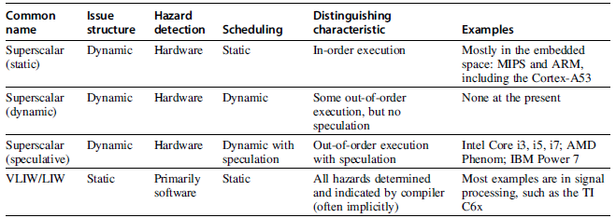
Comparison of different Multi-issue processors

Slide 12
Multi-issue and Static Scheduling VLIW
Static superscalar advantages diminish as issue width grows because the instruction execute in order and any hazard would stall the processor
VLIW processor issue a fixed length packet containing multiple instruction.
Each functional unit has a dedicated slot in the packet e.g integer operations in slot1 and slot2, while load/store in slot5

Slide 13
VLIW
To max utilize the benefit of multiple issue max slots should be utilized (ideally all the slots).
But it must be made sure to avoid hazards such as RAW etc. as it is the job of programmer or compiler
ILP can be achieved by exploiting parallelism within the basic block as well as loop unrolling.
If exploiting the parallelism requires scheduling code across branches, a substantially more complex global scheduling algorithm (e.g trace scheduling) must be used. (not covered in course)

Slide 14
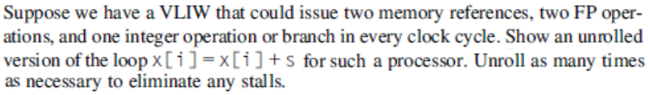
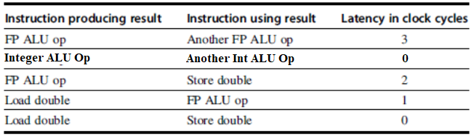
Example
C Code
RISC-V Assembly

Slide 15
Mem1 | Mem2 | FP Op1 | FP op2 | Integer/branch
fld f0,0(x1) | fld f1,-8(x1)
fld f2,-16(x1) | fld f3,-24(x1)
fld f4,-32(x1) | fld f5,-40(x1) | f.add f6,f0,f19 | f.add f7,f1,f19
 |  | f.add f8,f2,f19 | f.add f9,f3,f19
 |  | f.add f10,f4,f19 | f.add f11,f5,f19
fsd f6,0(x1) | fsd f7,-8(x1)
fsd f8,-16(x1) | fsd f9,-24(x1) |  |  | addi x1,x1,-48
fsd f10,16(x1) | fsd f11,8(x1) |  |  | bne x1,x2,loop

Slide 16
VLIW Problems
Technical
Code Size
Loop Unrolling
Unused function units had nops (Wasted bits)
Clever Encoding: e.g one large immediate field available for all functional units
Lockstep Operation
A stall in one functional unit will stall the whole processor and could be unpredictable e.g cache miss
Logistical
Binary Code compatibility

Slide 17
Superscalar
Multiple instructions are dynamically issued
Structural hazard is handled by processor
Statically scheduled perform in-order execution
If a dependent instruction is stopped, all following it are also stopped
Dynamically scheduled can use Tomasulo like scheme and perform out of order execution
Ofcourse multiple functional units are required

Slide 18
Superscalar: Issue stage
Issue logic is the most complex part and is the bottleneck
Instruction inside issue packet may be dependent on each other.
So dependence must be determined within a cycle and then all reservation station must be reserved updated in parallel.
every possible combination of dependent instructions in the same clock cycle must be considered and combinations increase as issue packet increase e.g in 4-issue 4th can be dependent on 1st , or 3rd can be dependent on 2nd and so on,..
Issuing multi instructions can be accomplished in two ways and modern processor may use both
Divide the issue stage in 2 stages (superpipelining) which run at twice the external clock (2-issue). But tables still need to updates for the following instruction. Cannot be easily extended to issue 4.
Widen the units so that they can issue multi instructions. Instruction dependency is analyzed in parallel and reservation stations are updated

Slide 19
Superscalar: Considerations per cycle
Issue
Preallocate n reorder buffer entries while also making sure that reservation stations are available for any combination of instruction
For successful preallocation reservation stations demand can be reduced by limiting no. of instruction for any particular functional unit instruction (e.g. only 2 floating point multiplications
If still there is shortage of reservation stations then bundle is broken and remaining are issued in next packet
Analyze all dependencies among instructions
If the instructions dependent on instructions inside bundle then use the assigned reorder buffer entries to update the table
If the instruction are dependent on earlier instruction then use existing reservation table entries
Execution and Commit: Multiple instructions can commit per cycle

Slide 20
Example

Slide 21
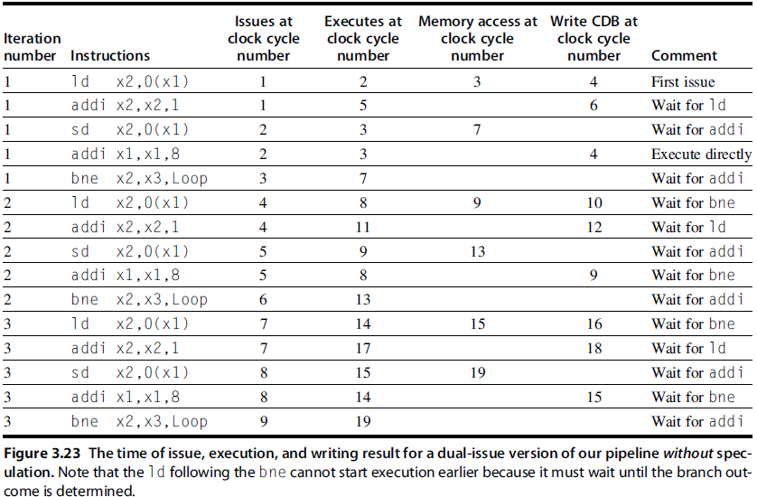

Slide 23
Advanced Techniques for Instruction Delivery and Speculation
In multi-issue special arrangements are needed to maintain issue rate
It requires
Wider Path
Removing branch stalls
Advance Speculation techniques

Slide 24
Increasing Instruction Fetch Bandwidth: Using Branch Target Buffer
Branch prediction reduces stall but doesn’t eliminate it
In standard 5-stage pipeline we still have 1 stall with branch prediction if branch is taken, because the branch target is figured out in the decode stage. So there is still one bubble if prediction is true and branch is taken
A branch target buffer is like a cache and it stores the target address of taken branches
In fetch stage the address of instruction is matched with entries in BTB (before decoding the instruction)

Slide 27
Example

Slide 28
So on average 0.38 cycles will be wasted due to branch. 1 cycle for branch execution is excluded
Branch Folding
One variation on the branch-target buffer is to store one or more target instructions instead of, or in addition to, the predicted target address.
It actual target instructions allows us to perform an optimization called branch folding(consider out of order execution).
Branch folding can be used to obtain 0-cycle unconditional branches and sometimes 0-cycle conditional branches. (i.e. Because IF stage is skipped)

Slide 29
Increasing Instruction Fetch Bandwidth Specialized Branch Predictors for Indirect Jumps
Indirect branches such as in Indirect Jumps and Procedure returns pose extra challenge for speculation
These jumps use jump register instruction in assembly.
Switch case is converted to a table (jump table) of address in memory. The index to table is made using input and table starting addresses. The value is loaded in register and jr reg jumps to target
Similarly jump back from procedure also uses jr reg.
In both cases above instruction is same but address varies which seriously affect prediction

Slide 30
Increasing Instruction Fetch Bandwidth Specialized Branch Predictors for Indirect Jumps
The procedure return problem can be improved by adding a buffer (cache) which acts as a stack for indirect jumps.
It contains the address of recent procedure return addresses.
On each call address is pushed in stack and on return it is popped.
So for indirect jumps use a separate return address predictor instead of the predictor for direct jumps

Slide 31
Increasing Instruction Fetch Bandwidth: Integrated Instruction Fetch Units
Divide the processor in two ends Frond end and back end
Front end is Instruction fetch unit. So it is not considered as just one stage of pipeline.
The interface between front end and back end is buffer which contains instructions to be issued
It is now an autonomous unit that has following features
Integrated branch prediction: It is part of IF unit and is constantly predicting branches .
Instruction prefetch:, The unit autonomously manages the prefetching of instructions integrating it with branch prediction to deliver multiple instructions per clock.
Instruction memory access and buffering: To maintain bandwidth in multissue, it may require to jumping to different blocks in cache. The delay is hid using prefetching and also by including a buffer inside fetch unit

Slide 32
Speculation: Implementation Issues and Extensions Renaming using Merged Register File
Renaming using reorder buffer has certain disadvantages (and also advantages, so still high end processors use it)
Register values are written twice, once in reorder buffer and then in register file when instruction commits. So more power consumption
Source operand may come from two locations; register file and reorder buffer. It increases the interconnect for data to be sent to reservation stations.
Merged register file has two sets of registers.
Architectural Registers: Visible to programmer (Compiler)
Physical Registers: Not visible. For renaming. Hold speculative results like reorder buffer and in other variant also hold committed

Slide 33
Renaming using Merged Register File
There are two variants are (not much difference)
There are Architectural registers which also physically exists and another set of Extended Physical registers to hold speculative results and for renaming. At Commits their values are moved to Architectural registers
Architectural registers are logical registers. Physical registers contain both speculative and committed values.
In both cases Physical registers are much larger in no as compared to Architectural registers.
Reorder buffer function to keep track of order for commit is still present.

Slide 34
Renaming using Merged Register File
A renaming table maps Architectural registers to Physical registers and also keeps track of free registers
All the destination registers of instruction being issued are assigned to the free registers and This way the WAR and WAW dependencies are eliminated
Consequently the following instructions which have a RAW dependency also update their operands likewise.
So an architectural register can be mapped to multiple physical registers.
When an architectural register is commited, the previous physical register is freed. For example if R1 is mapped to physical registers R5 and R6. So when R6 is committed, then we are sure that R5 has no use and it can be added to free list

Slide 35
Example
Physical Registers | Architectural Registers
r1 | r1
r2 | r2
r3 | r3
r4 | r4
r5 | r5
r6 | r6
r7 | free
r8 | free
r9 | free
r10 | free
r11 | free
r12 | free
RAW between i2 and i1 for r1
WAR between i3 and i2 for r5
WAW between i4 and i1 for r1
i1:Add r1,r2,r4
i2:Sub r3,r1,r5
i3:Mul r5,r1,r6
i4:Add r1,r6,r5
Suppose initially table is

Slide 36
The code after mapping is
i1:Add r7,r2,r4
i2:Sub r8,r7,r5
i3:Mul r9,r7,r6
i4:Add r10,r6,r9
Physical Registers | Architectural Registers
r1 | r1
r2 | r2
r3 | r3
r4 | r4
r5 | r5
r6 | r6
r7 | r1
r8 | r3
r9 | r5
r10 | r1
r11 | free
r12 | free
As we can see that all WAR and WAW dependencies are removed and RAW dependencies are maintained
Since r1 was already mapped to r1 before first instruction, it means it is already used as an operand or dest. of an instruction. Thus using as new dest. without renaming will cause WAR or WAW.
As can be seen, an arch. Reg can be mapped to multiple physical reg which may result in shortage if unused or not freed.
How to know when a Physical register can be freed?
The safest and easiest (but not the optimum) way is to wait until the latest register for the same Arch. register commits. Then previous can be freed.
For example in above example, r7 (earlier mapping of r1) can be freed when r10 (later mapping of r1) commits because no dependent instruction for r7 can exist after it

Slide 37
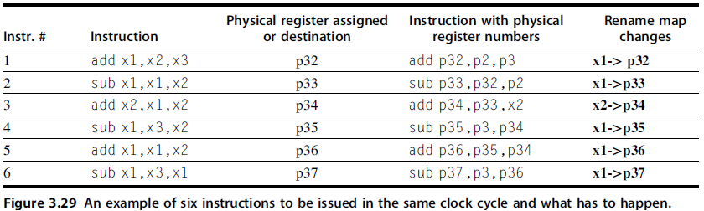
Speculation: Implementation Issues and Extensions The Challenge of More Issues per Clock
Once branch prediction is accurate thus speculation is optimum, issue rate can be considered to increase.
Duplicating function unit is straightforward
Renaming example below again describes the complexity of issue is the bottleneck and (thus commit which is dual)

Slide 38
The Challenge of More Issues per Clock
The difficulty is that all task of finding dependency and rewriting must must be done in a cycle

Slide 39
Speculation: Implementation Issues and Extensions How Much to Speculate
Although Speculation has many advantages but it has certain disadvantages which limit how much we speculate.
It takes time and energy to recover from incorrect speculation
In order to maintain high execution rate for speculation, the processor must have additional resources which take area and power.
Optimum branch prediction (more caches/buffers i.e predictors)
Multiple functional unit
If speculation causes an exception to occur (e.g. cache miss), it will significantly reduce performance
Most processor allow only low cost exceptions (1st level cache miss) to handled in speculation.

Slide 40
Speculation and the Challenge of Energy Efficiency
Instructions that are speculated and whose results are not needed generate excess work for the processor, wasting energy.
Undoing the speculation and restoring the state of the processor consumes additional energy.
if speculation lowers the execution time by more than it increases the average power consumption, then the total energy consumed may be less.
SPEC2000 benchmarks results show that misspeculation is high for integer programs and low for floating point programs so a clever scheme is needed

Slide 42
Speculating Through Multiple Branches
We have only seen speculation through single branch
Database and integer computation programs have clustering of branches, so they may benefit from speculating multiple branches and in some case multiple branches per clock (as of 2017 no processor performs multiple branches per clock)
Multiple branches per cycle means multiple prediction per cycle, so multiported branch prediction buffers
Getting instructions from non-contagious locations

Slide 43
Address Aliasing Prediction
Predicts whether two stores (WAW hazard); or a load and a store refer to the same memory address (RAW and WAR hazards).
If they are no the same then we can interchange.
We don’t need to predict exact addresses. Only predict whether the both match.
Processor must also have mechanism to recover after misprediction as we do in the case of mispredicted branches.
It is a simple form of Value Prediction (which after almost 15 years of research isn’t available in any processor).
In value prediction we predict the value produced by an instruction and thus eliminate data dependence restrictions.

Slide 44
Multithreading: Exploiting Thread-Level Parallelism to Improve Uniprocessor Throughput
Multithreading uses thread level parallelism but it improves pipeline utilization. That is why it is discussed here.
With speculation and prefetch there is still chance that all stalls cannot be hidden e.g. a cache miss
Multithreading is a technique in which multiple threads share a processor without the need of context switch.
Threads of a process have separate PC and state (registers) but they share the same data space (i.e code and data segment).
So in processor which supports multithreading, there are separate PCs and registers for each thread but all share the functional units.
Thus while in-order execution may stall the processor, it is avoided by executing instructions from other threads meanwhile.
For dynamic scheduling it is needed to have per thread renaming table alongwith separate registers and PC.
Of course to get benefit from multithreading a program must have multiple threads

Slide 45
Multithreading Types
Three approaches
Fine-grained(static scheduling):
Switching between threads on each cycle (interleaving in round robin fashion)
A thread is skipped if it has stall whether due to data dependence or any cache miss
no out of order execution ie. Static scheduling. Thus no dynamic scheduling hardware (e.g reservation station). Thus multiple 5 stage pipelines in parallel.
Coarse-grained(static scheduling):
Switches threads only on costly stalls, such as level two or three cache misses.
Simultaneous Multithreading:
When Fine-grained multithreading is used on superscalar with dynamic scheduling.
It issue from one thread. SMT executes instructions from multiple threads, leaving it up to the hardware to associate instruction slots and renamed registers with their proper threads.
In fine-grained multithreading only those instructions are issued whose operands are available whereas with dynamic scheduling those instructions are also issued whose operands are being calculated

Slide 47
Multithreading Types
Fine-grained:
Increase Multi-thread throughput but increases the latency of a single-thread
Coarse-grained:
Less likely to slow down the execution of any one thread.
It has throughput losses
Thread is not switched for small stalls (e.g L1 cahe miss)
Thread is only switched on a stall therefore there is a stall (bubble) in the pipeline before every switch
No major current processor uses this technique.

Slide 48
Simultaneous Multithreading
Effectiveness of SMT was explored in 2000-2001, assuming Dynamic superscalar will get much wider in next few years with
Supporting six to eight issues per clock with
Many simultaneous loads and stores
large primary caches,
Four to eight contexts with simultaneous issue and commit
In practice, the existing implementations of SMT offer
only two to four contexts with fetching
Issue from only one,
Up to four issues per clock.
The result is that the gain from SMT is also more modest.

